Slide 1
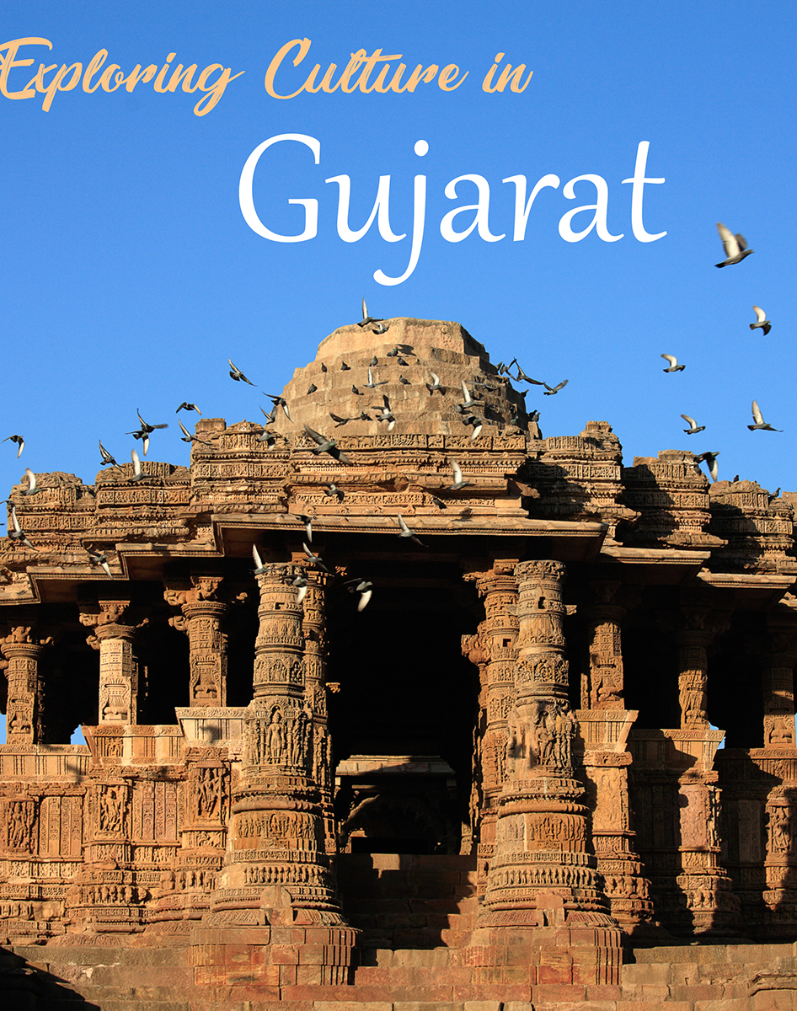
RICH and Varied culture of Gujarat

Slide 2
Agenda
Introduction
Languages
Costumes
Food
Gujarati Cinema
Fairs and Festivals
Dance Forms

Slide 3
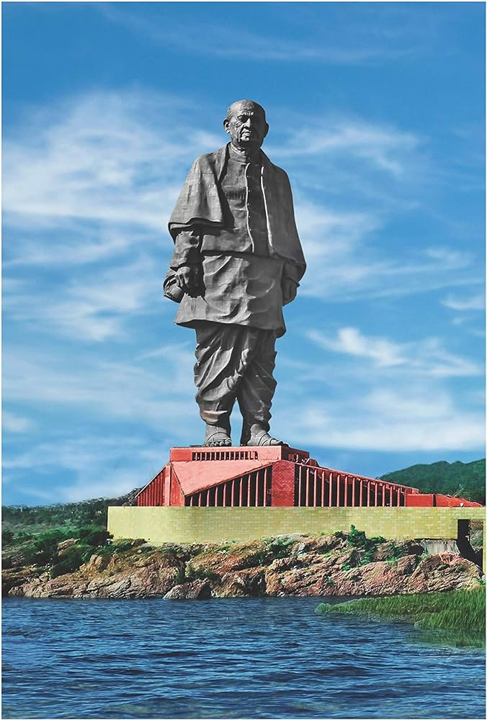
Introduction

Slide 4
Gujaratis, originally known as Gurjars, are influenced by historical values of arts, culture, and traditions.
Gujarat's culture is influenced by enculturation, a process where culture is shared and passed on from one generation to the next.
Gujarat has a strong cultural influence from its socio-economic-political history and is significant in Indian Political History as the birthplace of Mahatma Gandhi.
Gandhi's system of non-violence is a major influence on the people of Gujarat.
Festivals, fairs, arts and crafts, folk dances, music, cuisine, and lifestyles form a major part of Gujarat's cultural background.
The culture of Gujarat is homely and blended with values and moral characteristics.

Slide 5
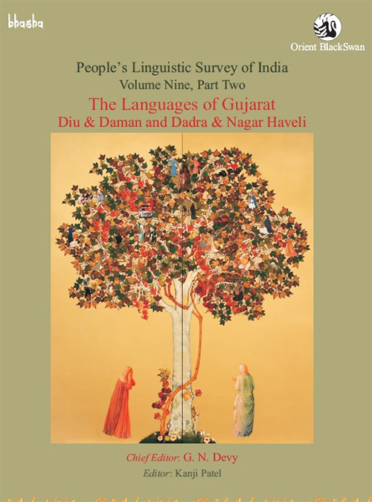
LANGUAGES

Slide 6
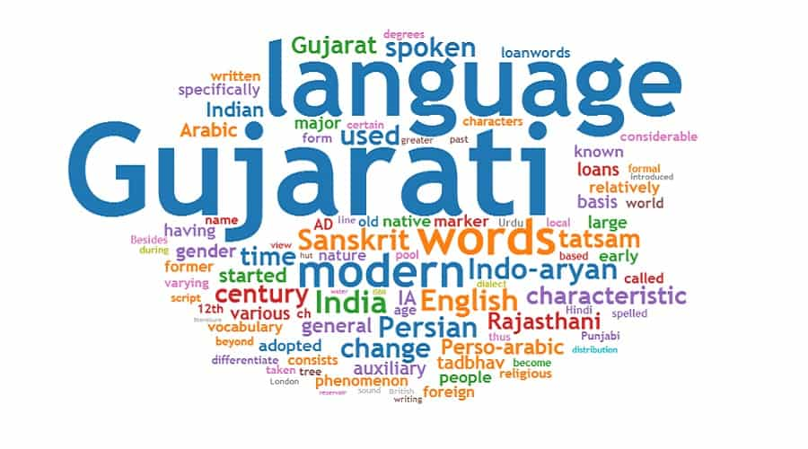
Gujarati is the local language and the mother tongue of the people in Gujarat.
Gujarati is spoken globally wherever Gujaratis reside.
Other regional languages spoken in Gujarat include Surti, Charotari, Kathiawai, and Kutchi.
In addition to these, other Indian languages like Marathi, Sindhi, and Punjabi are also spoken in various regions of Gujarat.

Slide 7
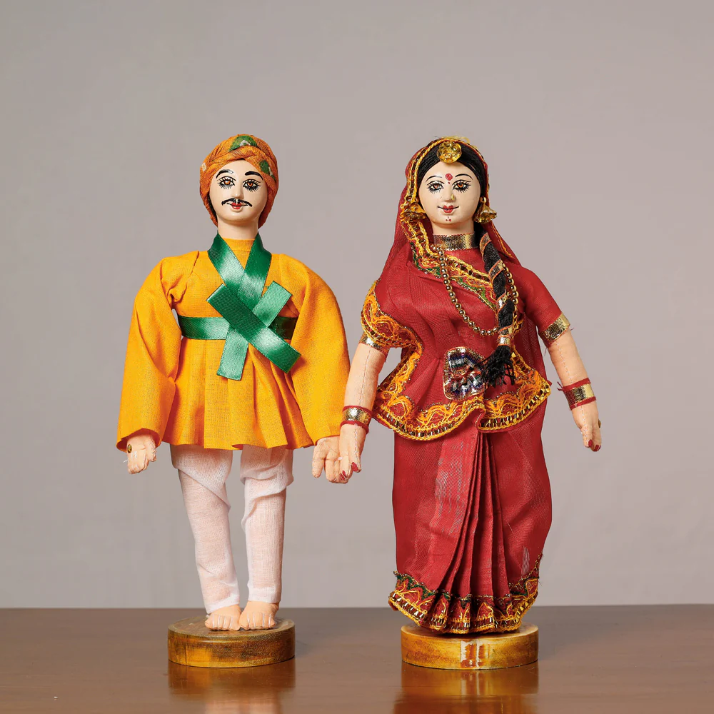
Costumes

Slide 8
The costumes in Gujarat vary based on whether people live in rural or urban areas.
Men in Gujarat generally wear trousers and shirts or t-shirts.
Younger women in Gujarat often wear western outfits like skirts, dresses, and jeans.
Older women in Gujarat typically wear saris or salwar Kamiz.
In rural parts of Gujarat, people often wear Dhotis and Kurtas or Bandis.
Traditional outfits like Chania Choli are worn by women and Kedia dress by men in rural areas or during cultural festivals, i.e., Navratri Mahotsav.
The region of Kutch has a distinctive traditional outfit adorned by women known as Abhas.

Slide 9
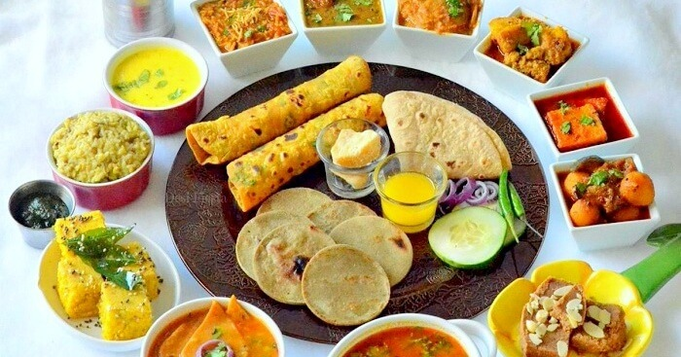
FOOD

Slide 10
The majority of Gujaratis are vegetarian.
A traditional Gujarati meal, known as 'Gujarati Thali', consists of dal (lentils), roti, rice, and vegetables, along with salads, farsan (snacks), and a sweet dish, followed by chaas (buttermilk).
The evening meal often consists of 'bhakri-shak' (bread with vegetable curry) or khichdi kadhi (a dish made from rice and lentils with a yogurt-based curry).
The typical diet of Gujaratis includes cereals, pulses, green vegetables, fruits, milk, ghee, and buttermilk.
Accompaniments like pickles, chutney, papad, and yogurt often complement the main menu.
Gujarati cuisine also includes a variety of other dishes, showcasing the culinary skills of Gujarati women.
Apart from traditional Gujarati food, dishes from other regions like South Indian food, Continental, and Chinese cuisines are also prepared.

Slide 11
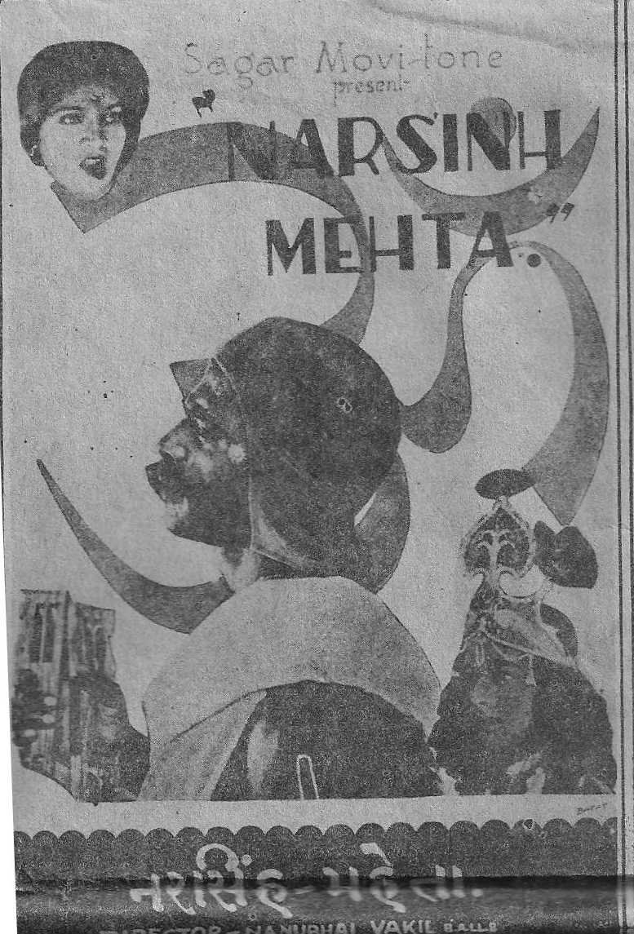
Gujarati Cinema

Slide 12
Gujarati cinema, also known as 'Dhollywood' or 'Gollywood', is characterized by strong themes of mythology, history, social and political aspects.
Even before the establishment of the industry, movies were made on Gujarati culture and its people during the silent movie era.
Gujarati cinema is more than just a means of entertainment; it represents various forms of cinematic art.
Going to the cinema is a popular pastime among the Gujarati locals.
The industry released its first movie, Narsinh Mehta, in 1932.
The Gujarati community has preserved their rich traditions and customs, which have deep roots in their past.
The mingling of diverse ethnic groups has resulted in a community that displays qualities like friendliness, liveliness, unity, and a deep appreciation for their various ancient art forms.
The culture of Gujarat is a blend of numerous traditions with a touch of modernization.

Slide 13
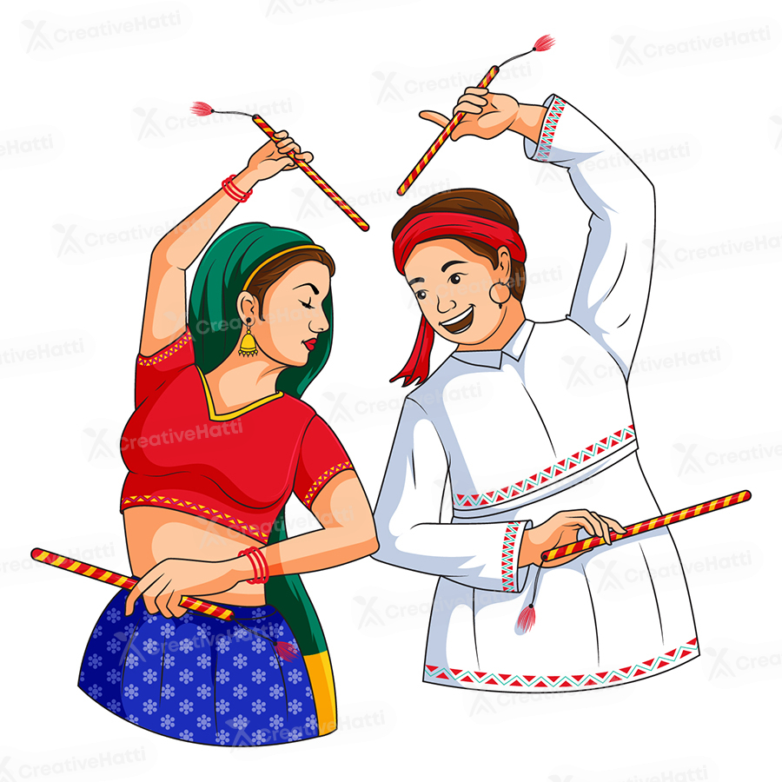
Fairs and Festivals

Slide 14
The fairs and festivals of Gujarat reflect the vibrant and colorful culture of the state.
Major festivals like Navratri Mahotsav, Deepawali, Rathyatra, and Kite festival attract thousands of visitors to Gujarat.
Fairs such as Shamlaji Melo, Bhadra Purnima Fair, and Mahadev Fair are organized annually in the state.
The Rann Utsav is a significant festival that showcases a grand carnival of music, dance, and natural beauty.

Slide 15
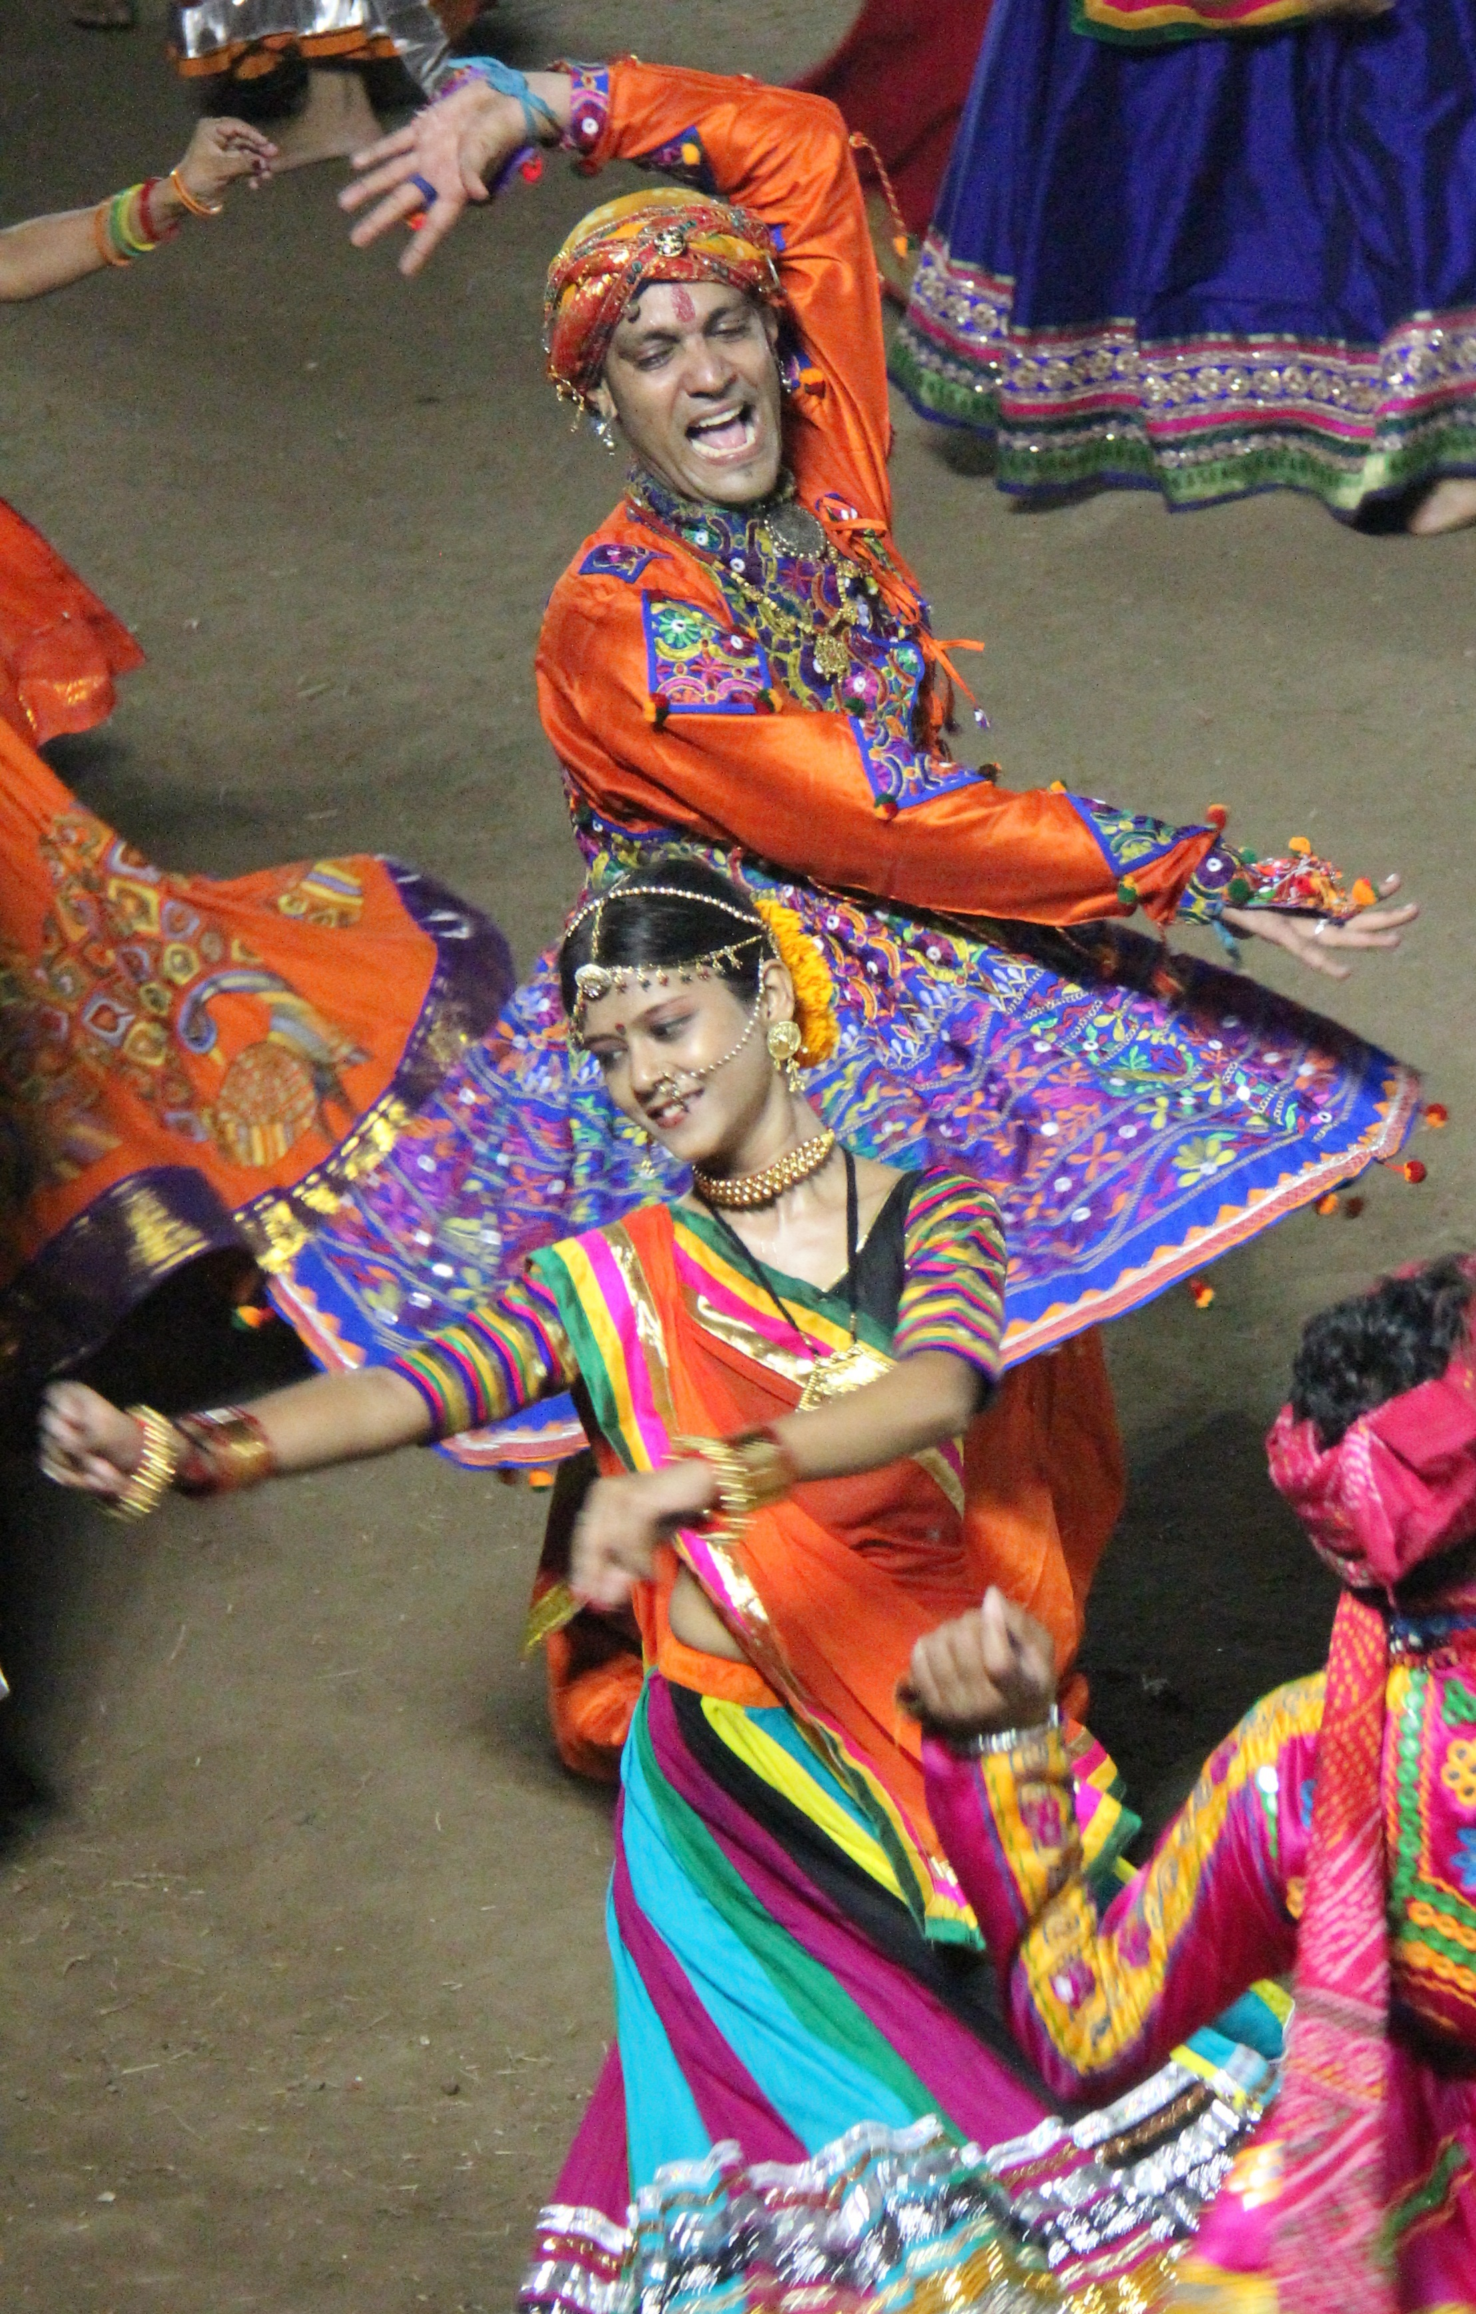
Dance forms

Slide 16
Since Gujarati people are quite enthusiastic and amiable, they have many traditional forms of dance. The four major forms of dance are Dandiya Raas, Garba, Padhar, and Garbi.
Dandiya Raas is performed by both men and women and utilizes the movement of bamboo sticks, known as Dandiyas. It has ancient roots and was believed to be played by the beloved Gopis of Lord Krishna.
Garba is usually performed by the females in a circular formation. It is performed with reverence of the feminine form of the divinity.
Garbi is traditionally performed by only the men and incorporates the use of instruments like dhol and manjiras.
Padhar is mainly performed by the rural communities near Nal Lake.

Slide 17
Thank you

